Slide 1
Business plan
Earth cup
Group project - TEK4900

Slide 2
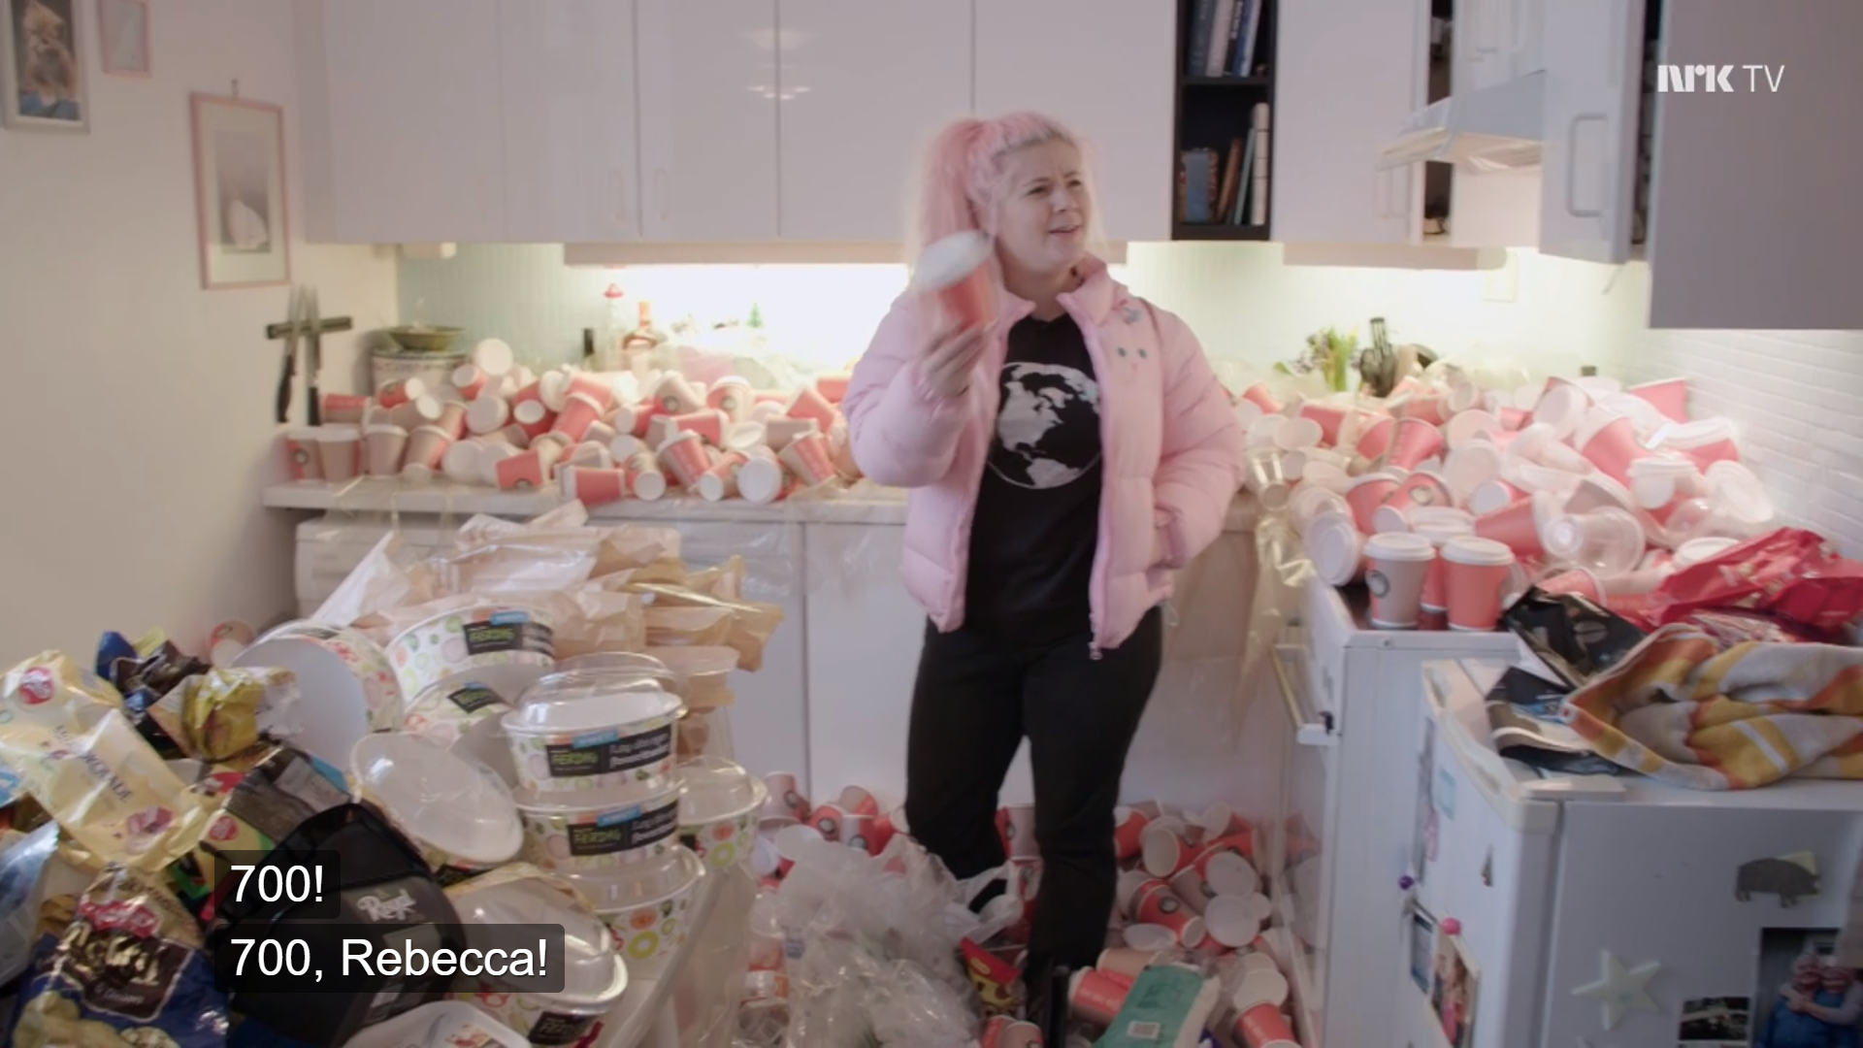
Planet Plast - NRK 2018
https://tv.nrk.no/serie/planet-plast

Slide 3
Disposable coffee cup facts
Most cups are made from non-renewable materials and cannot be recycled and will most likely end up in a landfill or in the environment.
500.000.000.000
Cups outlive you
single use coffee cups are used and thrown away globally every year
200 liters of water
cups you have used for 15 minutes will outlast your time on earth
are used in the production of one disposable coffee cup
a lot of cups end up in the environment, where they become a major pollution hazard,
like most takeaway packaging, the cups are not biodegradable and most of them can't be recycled - even paper cups have a thin layer of plastic lining, which makes recycling difficult,
the majority are not made of renewable materials,
since you've started reading this article, 100.000 cups have gone to landfills!
1 million per minute
1 of 400 cups
0,11 kg CO²
coffee cups used globally
gets recycled
is sent into the atmosphere from the production of one single use cup
https://oneplanetzero.com/blogs/news/10-reasons-you-should-stop-using-disposable-coffee-cups

Slide 4
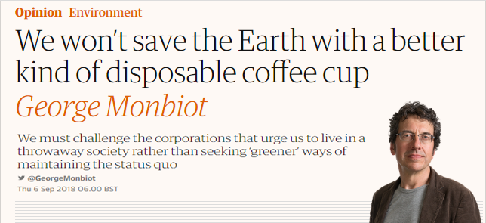
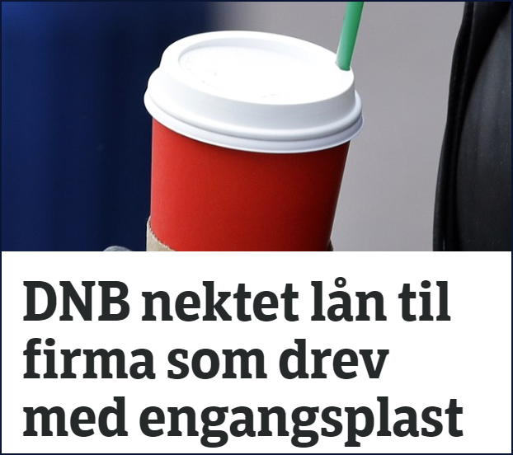
Trends
https://www.theguardian.com/commentisfree/2018/sep/06/save-earth-disposable-coffee-cup-green
https://www.nrk.no/hordaland/dnb-vil-droppe-lan-til-selskap-med-hoy-klimarisiko-1.14327672

Slide 5
Why? (Charlotte)
Present and document (if possible by numbers or statistics) the problem or the need – explain and create the legitimacy for why there is a need to put resources into and to come up with a new solution in your targeted area.

Slide 6
2. What? (Youssef)
Present your innovative idea / solution / business idea / product/service/company. Should be based on an innovation, something that is not done before (does not have to be radical, but should be a certain degree of novelty). Should also be somewhat realistic.

Slide 7
3. How? (Youssef)
Describe how the innovative idea/solution/product/service works and how it solves the initial problem addressed.

Slide 8
4. Value proposition (Youssef)
A good description of what is unique about the product. Why is this solution more likely to succeed than another solution (possibly proposed by competitors)?
End user
Coffee shops

Slide 9
5. Customers (Fatima)
Show plans for how your product/solution is to be communicated/diffused to customers / users/ implemented ..
How to reach customers

Slide 10
6. Market (Fatima)
Show the market potential.
Show that you have insight into the potential market/ applicability of the solution.
Has a user survey been accomplished?

Slide 11
7. Competitors (Charlotte)
Show that you are aware of what is going on in the market in general.
Describe competitors and their strengths and weaknesses and possibly a comparison to your solutiond.In which market do you want to introduce your solution first – and how could it possibly be expanded to other markets in later stages?
Local initiatives, fragmented,

Slide 12
8. Marketing and sale (Rishika)
Advertise - brand on the coffee cups
EARTH CUP
Make money on each coffee cup sold
Partnerships and benefits for both- coffee shops and customers- all coffee chains

Slide 13
9. Distribution (Rishika)
Distribution and subcontractors-Coffee shops

Slide 14
10. Organization (Youssef)
(If you are proposing a new company)
Show how the company is to be organized – that you cover various roles and that you possess the knowledge needed to succeed

Slide 15
11. Product development plan (Furkan)
Show how you are to succeed with product development and how IPRs are to be safeguarded.

Slide 16
12. Further development (Charlotte)

Slide 17
13. Budget (Furkan)
(3 - 5 years)

Slide 18
14. Capital needs (Furkan)
What do you need to succeed

Slide 19
15. Barriers / challenges (Furkan)

